Slide 1
Sistema de control carcelaria Cárcel Loja
Programación Orientada a Objetos

Slide 2
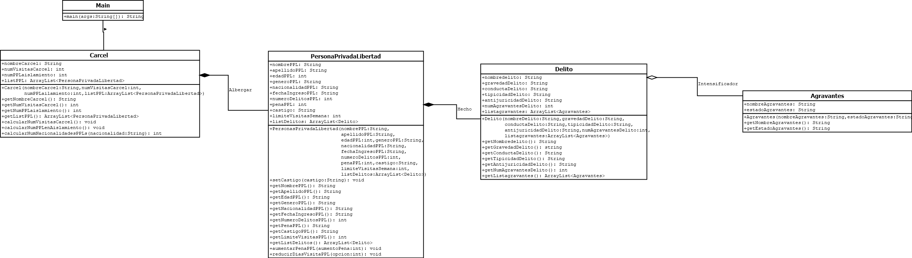

Slide 4
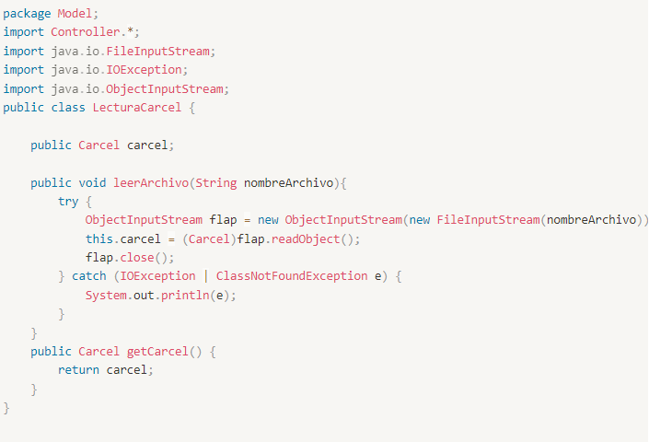
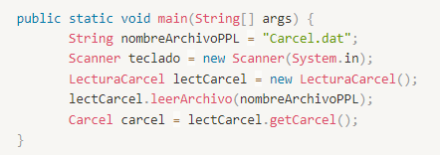

Slide 5
Ejecución
Código

Slide 6
Gracias por su Atención

Slide 7
CONTENTS OF THIS TEMPLATE
You can delete this slide when you’re done editing the presentation
FONTS | To view this template correctly in PowerPoint, download and install the fonts we used
USED AND ALTERNATIVE RESOURCES | An assortment of graphic resources that are suitable for use in this presentation
THANKS SLIDE | You must keep it so that proper credits for our design are given
COLORS | All the colors used in this presentation
ICONS AND INFOGRAPHIC RESOURCES | These can be used in the template, and their size and color can be edited
EDITABLE PRESENTATION THEME | You can edit the master slides easily. For more info, click here
For more info: Slidesgo | Blog | FAQs
You can visit our sister projects: Freepik | Flaticon | Storyset | Wepik | Videvo

Slide 8
TABLE OF CONTENTS
01
02
03
04
05
06
ABOUT US
MARKET ANALYSIS
GOALS & STRATEGY
CONTENT PLAN
BUDGET
KPI OVERVIEW

Slide 9

OUR COMPANY
Who are you? What market do you focus on? Why do clients keep choosing you? Here’s a paragraph you can use to describe what makes you unique. Tell a compelling story about how your company was born and how it has developed to become what it is today

